Slide 1


The UPC today

Slide 2

The UPC, the public university of engineering, architecture, sciences and technology

Slide 3

About the UPC

Slide 4



About the UPC
31,400
67
101
9
bachelor’s and master’s degree students
/ 31 % women
campuses
6,600
graduates of bachelor’s and master’s degrees
18
schools
bachelor’s degrees
master’s degrees
30
departaments
2,600
continuing education students
45
180
141
research groups
2,300
doctoral students
doctoral programmes
continuing education
programmes
3,700
2,200
100,700
411 M€
2025 budget
108 M€
income from RDI (2025)
teaching and research staff
technical, management, administrative and service staff
alumni

Slide 5
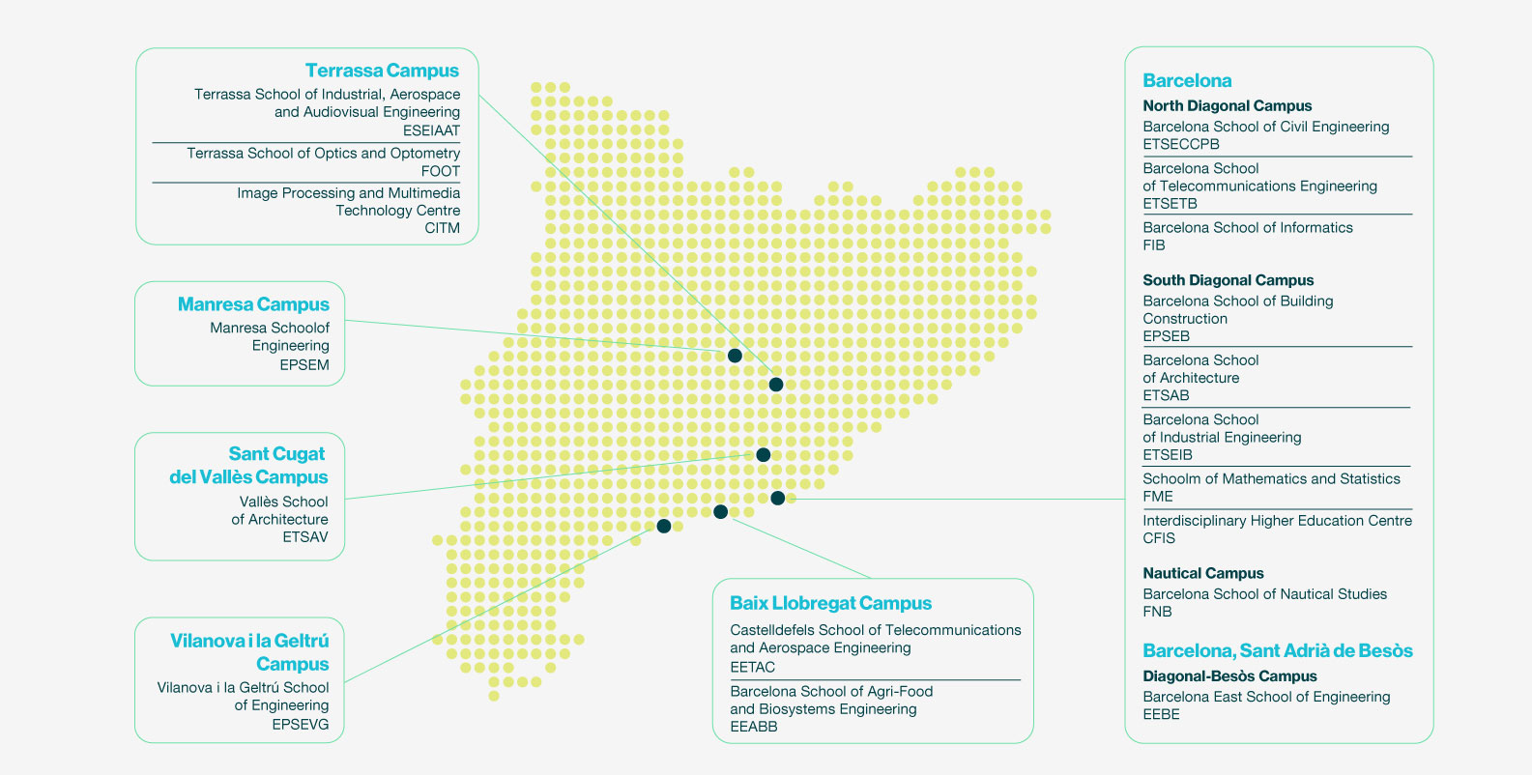
The UPC campuses in Catalonia, Spain

Slide 6
Schools and faculties
EEABB
Barcelona School of Agri-Food and Biosystems Engineering
EEBE
Barcelona East School of Engineering
EETAC
Castelldefels School of Telecommunications and Aerospace Engineering
EPSEB
Barcelona School of Building Construction
EPSEM
Manresa School of Engineering
EPSEVG
Vilanova i la Geltrú School of Engineering
ESEIAAT
Terrassa School of Industrial, Aerospace and Audiovisual Engineering
ETSAB
Barcelona School of Architecture
ETSAV
Vallès School of Architecture
ETSECCPB
Barcelona School of Civil Engineering
ETSEIB
Barcelona School of Industrial Engineering
ETSETB
Barcelona School of Telecommunications Engineering
FIB
Barcelona School of Informatics
FME
School of Mathematics and Statistics
FNB
Barcelona School of Nautical Studies
FOOT
Terrassa School of Optics and Optometry
CFIS
Interdisciplinary Higher Education Centre
CITM
Image Processing and Multimedia Technology Centre

Slide 7

Teaching

Slide 8

Teaching
25,900
bachelor’s degrees students
5,500
master’s degree students
2,300
doctoral students
2,600
continuing education students
6,600
graduates of bachelor’s and master’s degrees
6,000
students on work placement
100,700
alumni
67
101
45
180
9
campuses
18
schools
bachelor’s degrees
master’s degrees
doctoral programmes
continuing education programmes

Slide 9
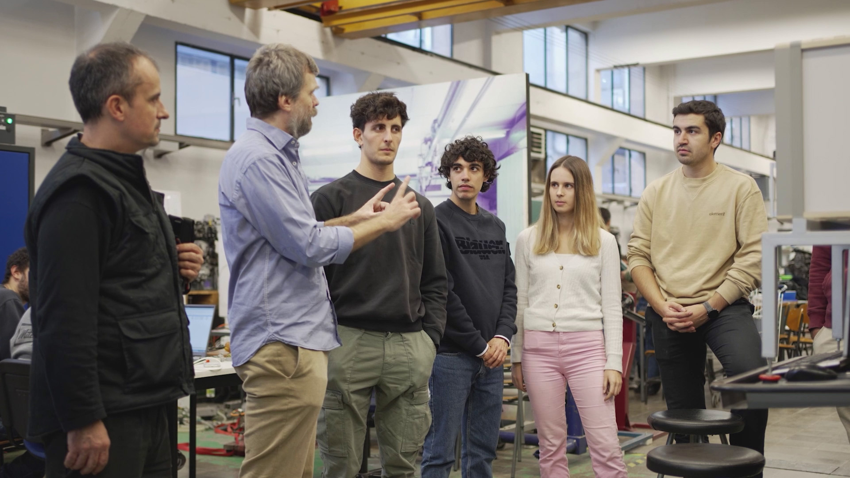

Slide 10
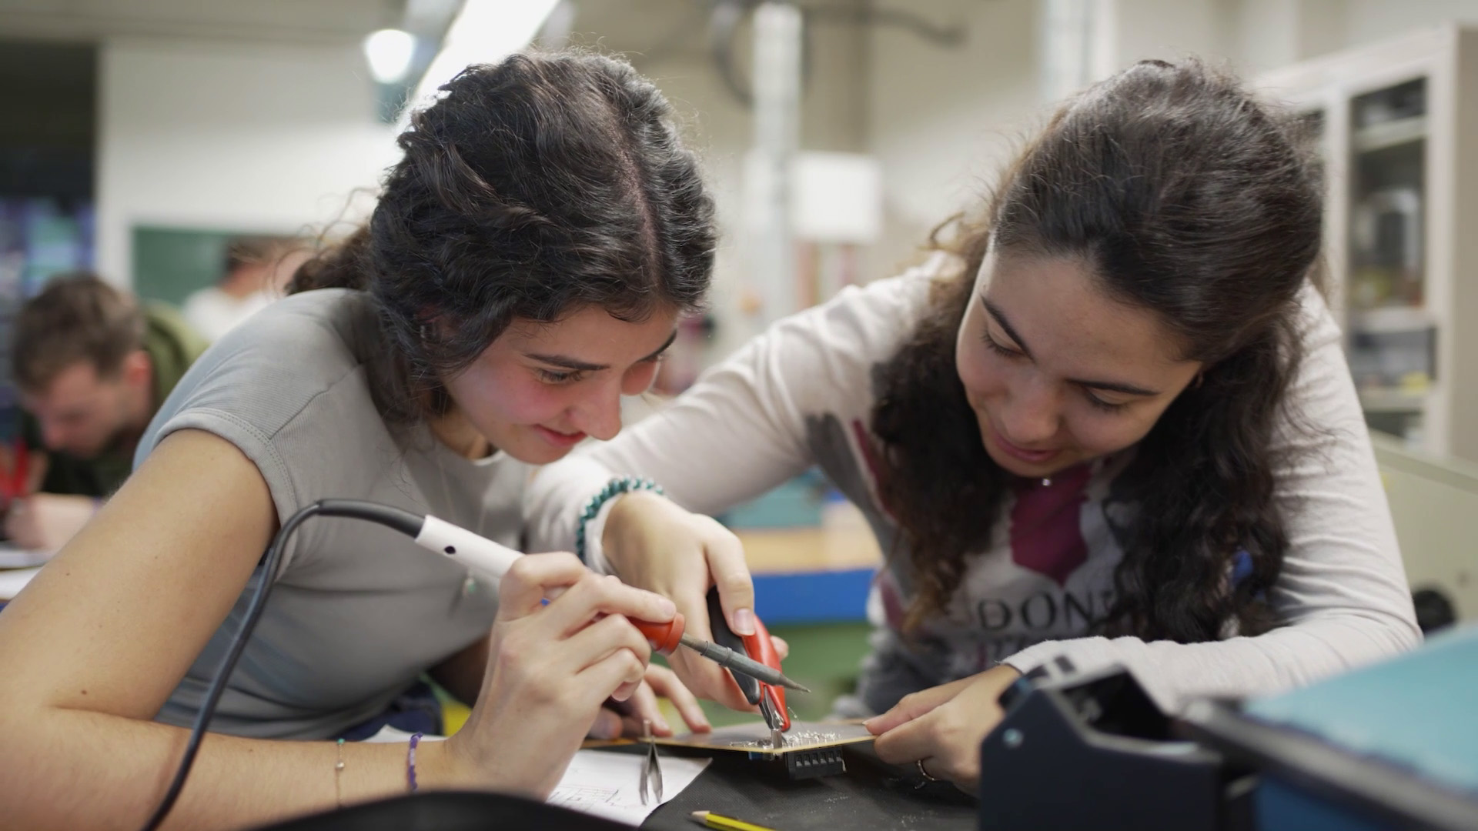

Slide 11
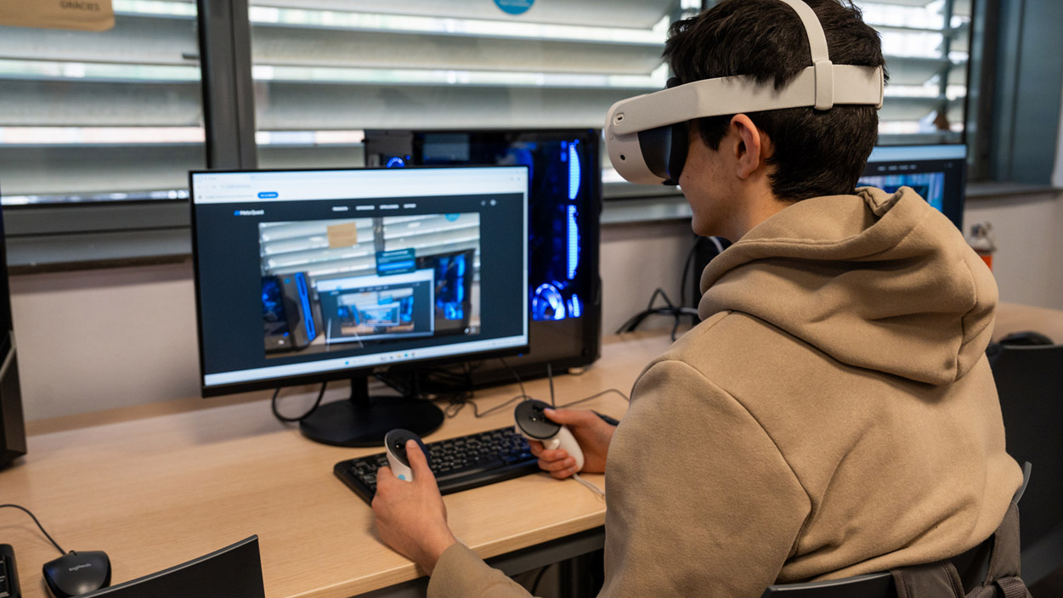

Slide 12
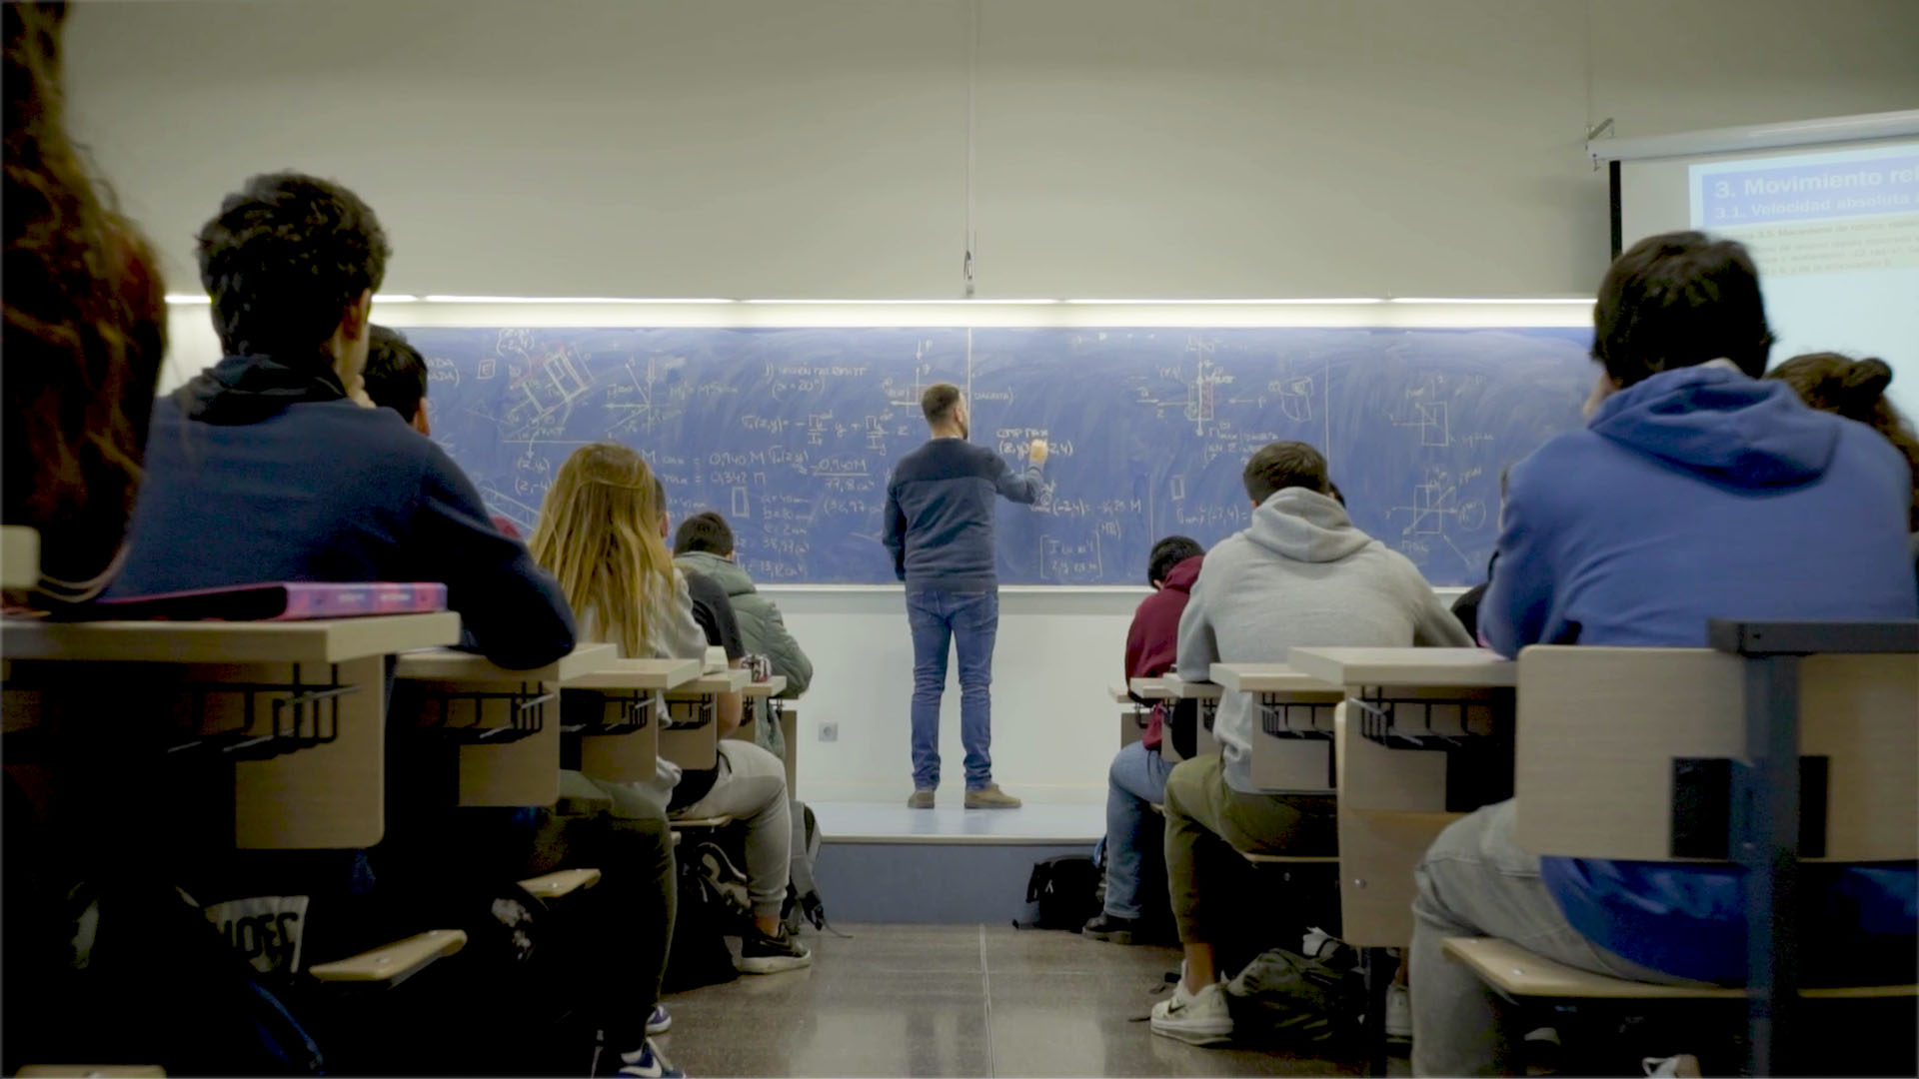

Slide 13

Research

Slide 14



Research
30
departments
141
research groups
5
research
institutes
21
specific research centres
12
associated research entities
3,700
teaching and research staff
2,579
scientific publications (2024)
2,300
doctoral students
345
thesis
Areas
architecture
urbanism and building construction
sciences
civil and environmental engineering
ICT engineering
industrial engineering
46
doctoral programmes
(curs 2025-26)
43
industrial doctorate projects
250
scientific and technical distinctions (2024)

Slide 15
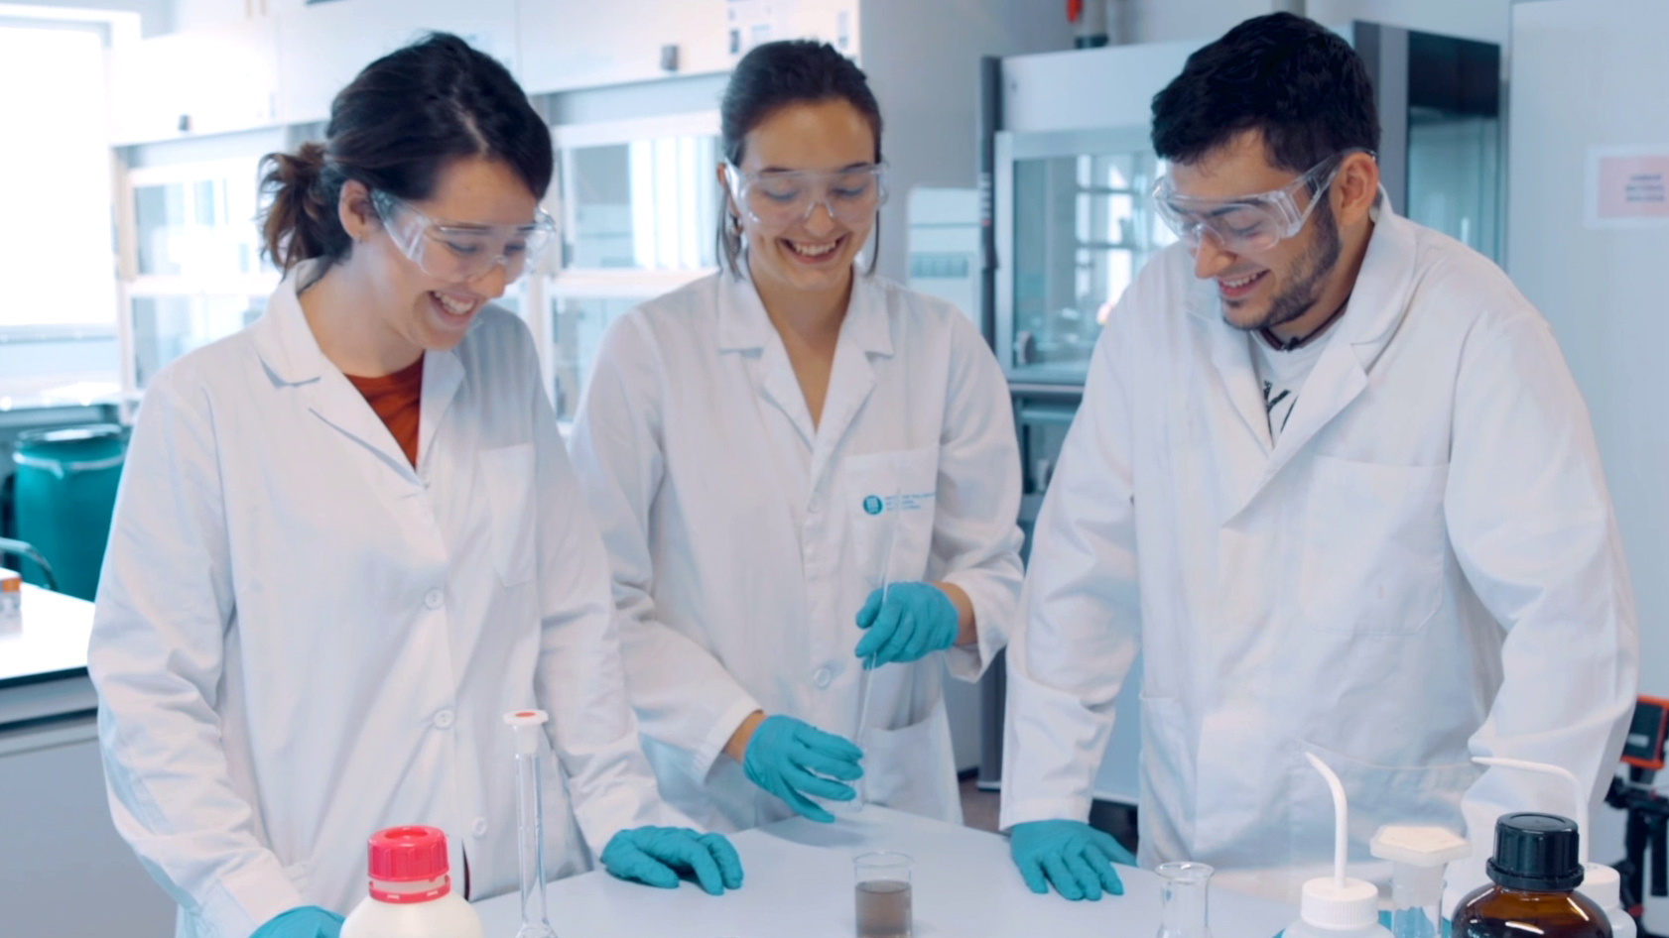

Slide 16
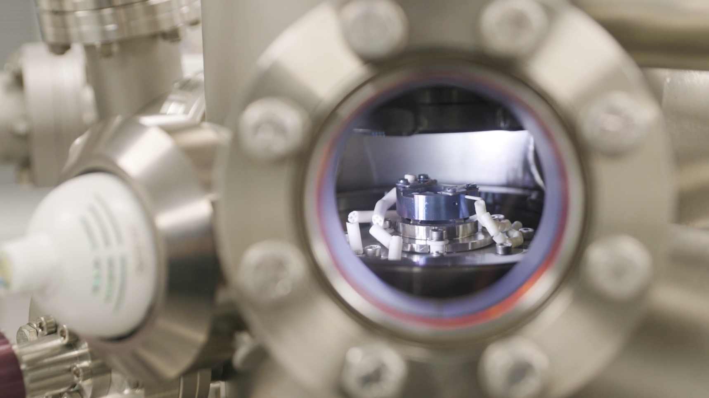

Slide 17
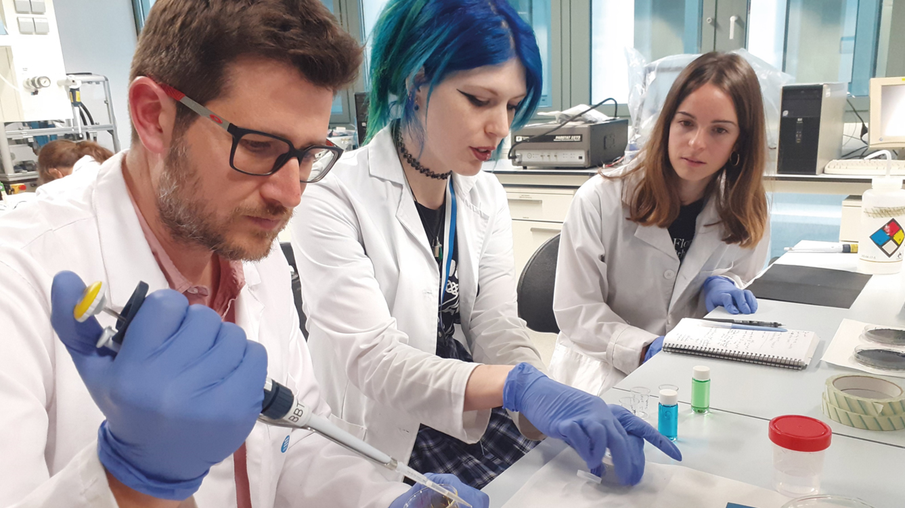

Slide 18
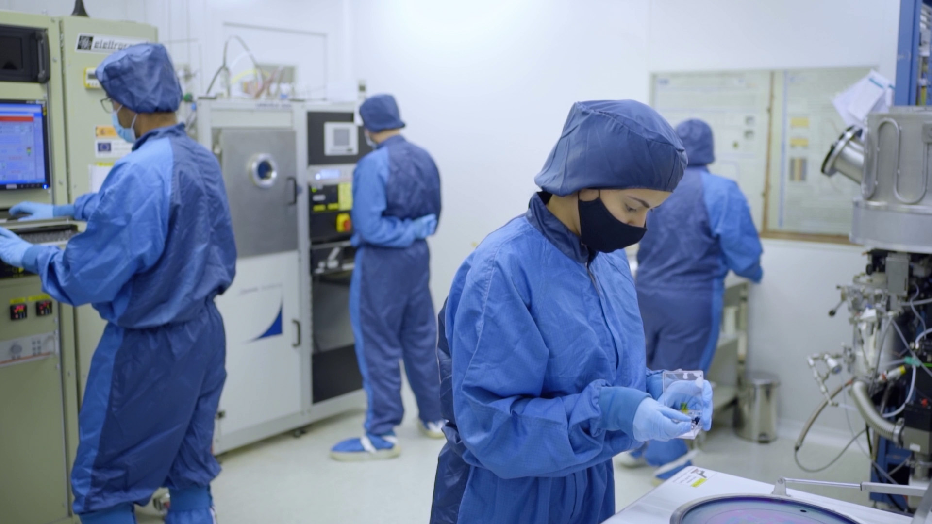

Slide 19
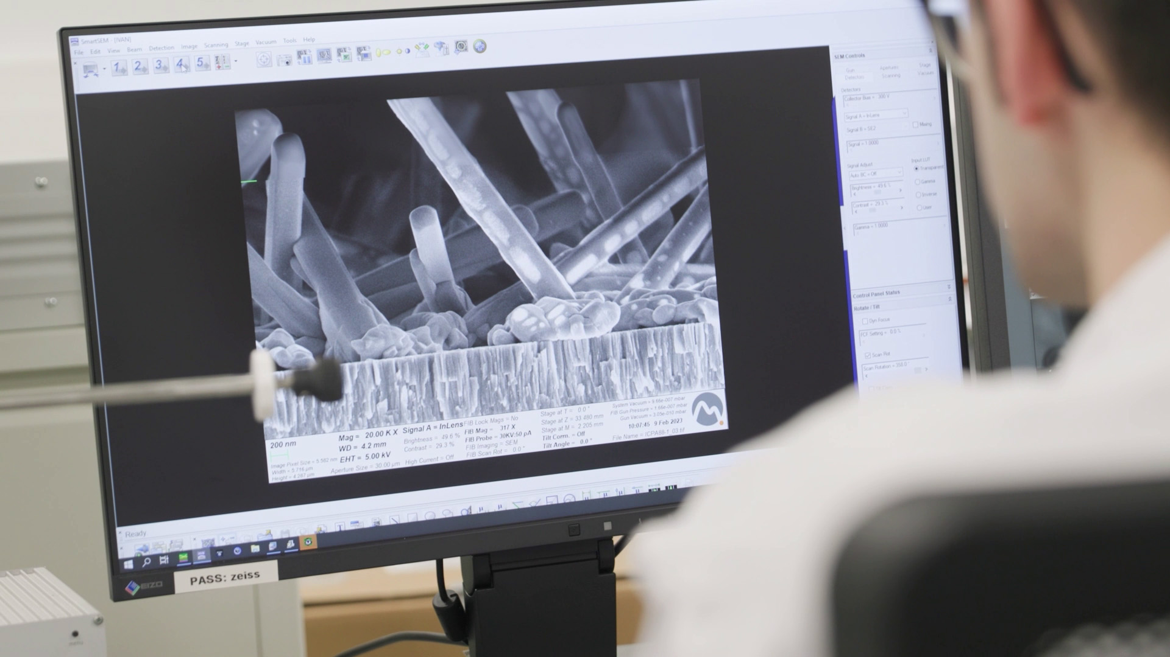

Slide 20

Transfer

Slide 21






Transfer
new patents
technology-based companies
companies and organisations with collaboration agreements
3,131
23
33
10
1,935
108 M€
income from RDI
new technological start-ups
active agreements and projects

Slide 22
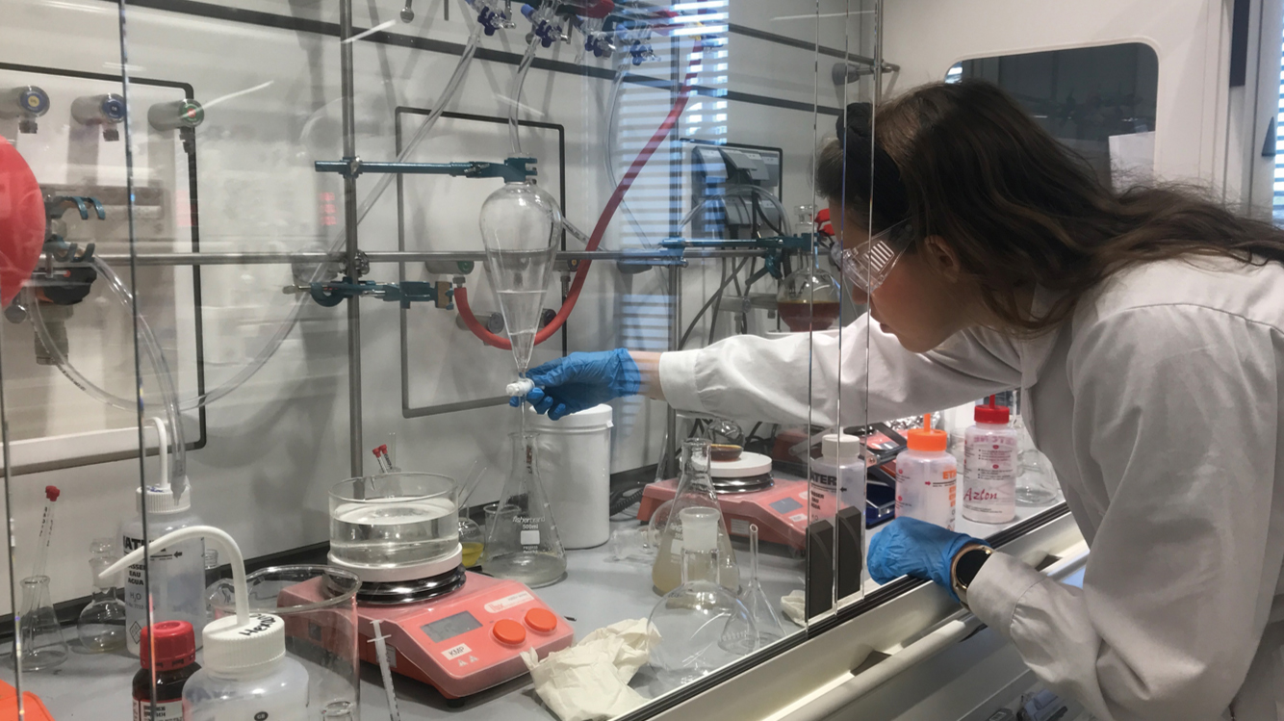

Slide 23
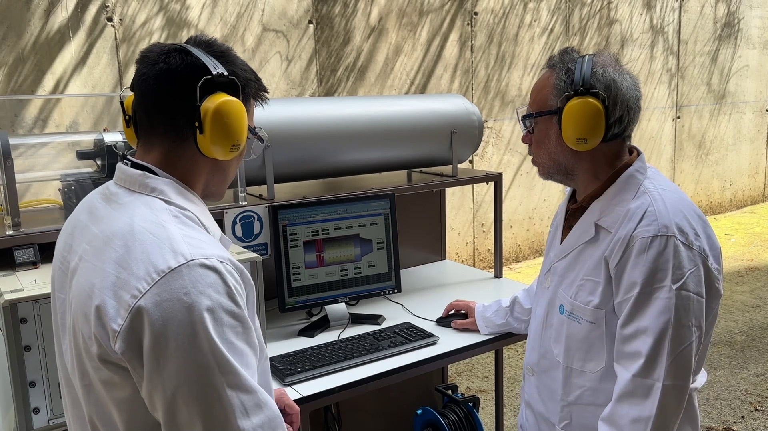

Slide 24
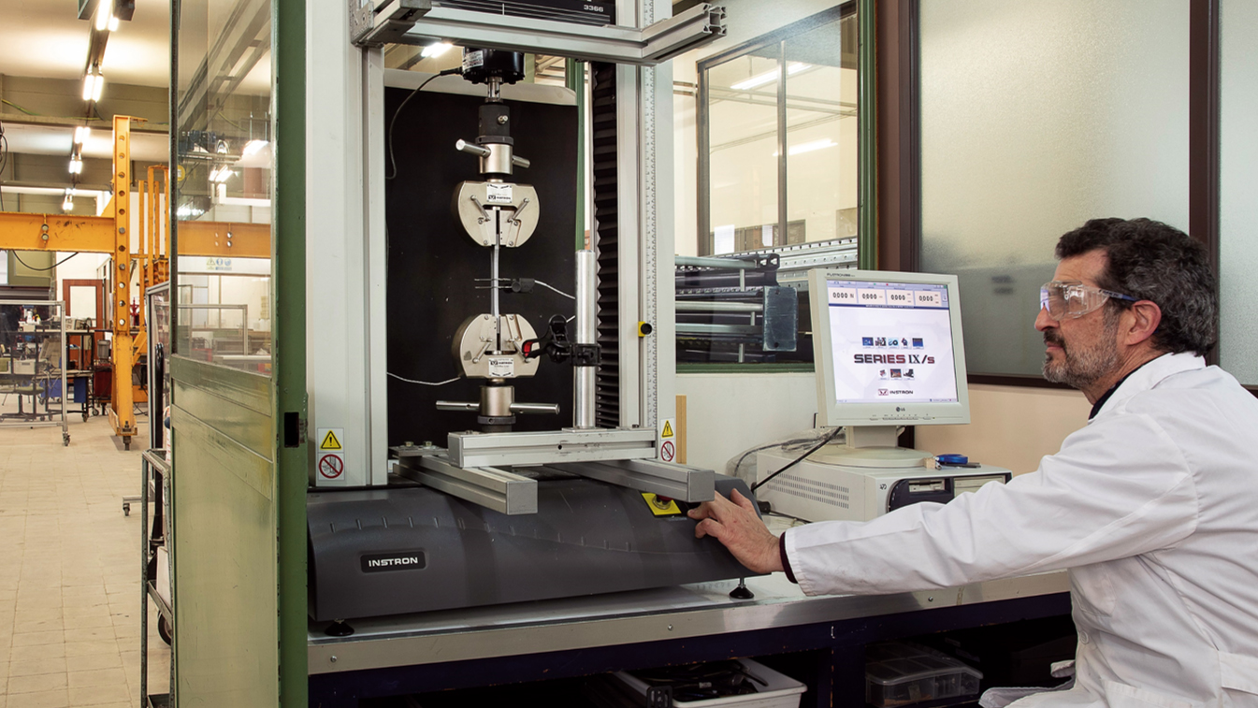

Slide 25

International

Slide 26


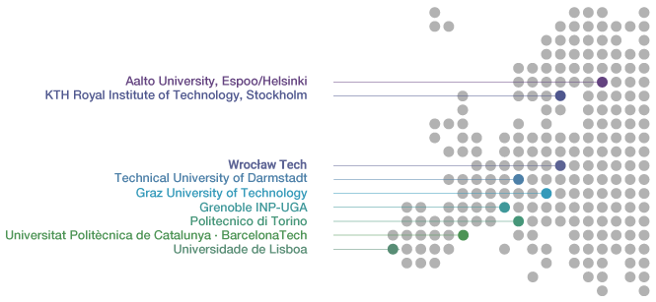


International
80
international double degree agreements with
1,600
student exchange agreements with
3,200 mobility students
47
universities
12
countries
695
universities
57
countries
1,750
1,450
International exchange students at UPC
UPC students on mobility programmes
270
educational cooperation agreements with institutions in over
1st
Spain’s university in projects funded through the Horizon Europe program
40
countries

Slide 27
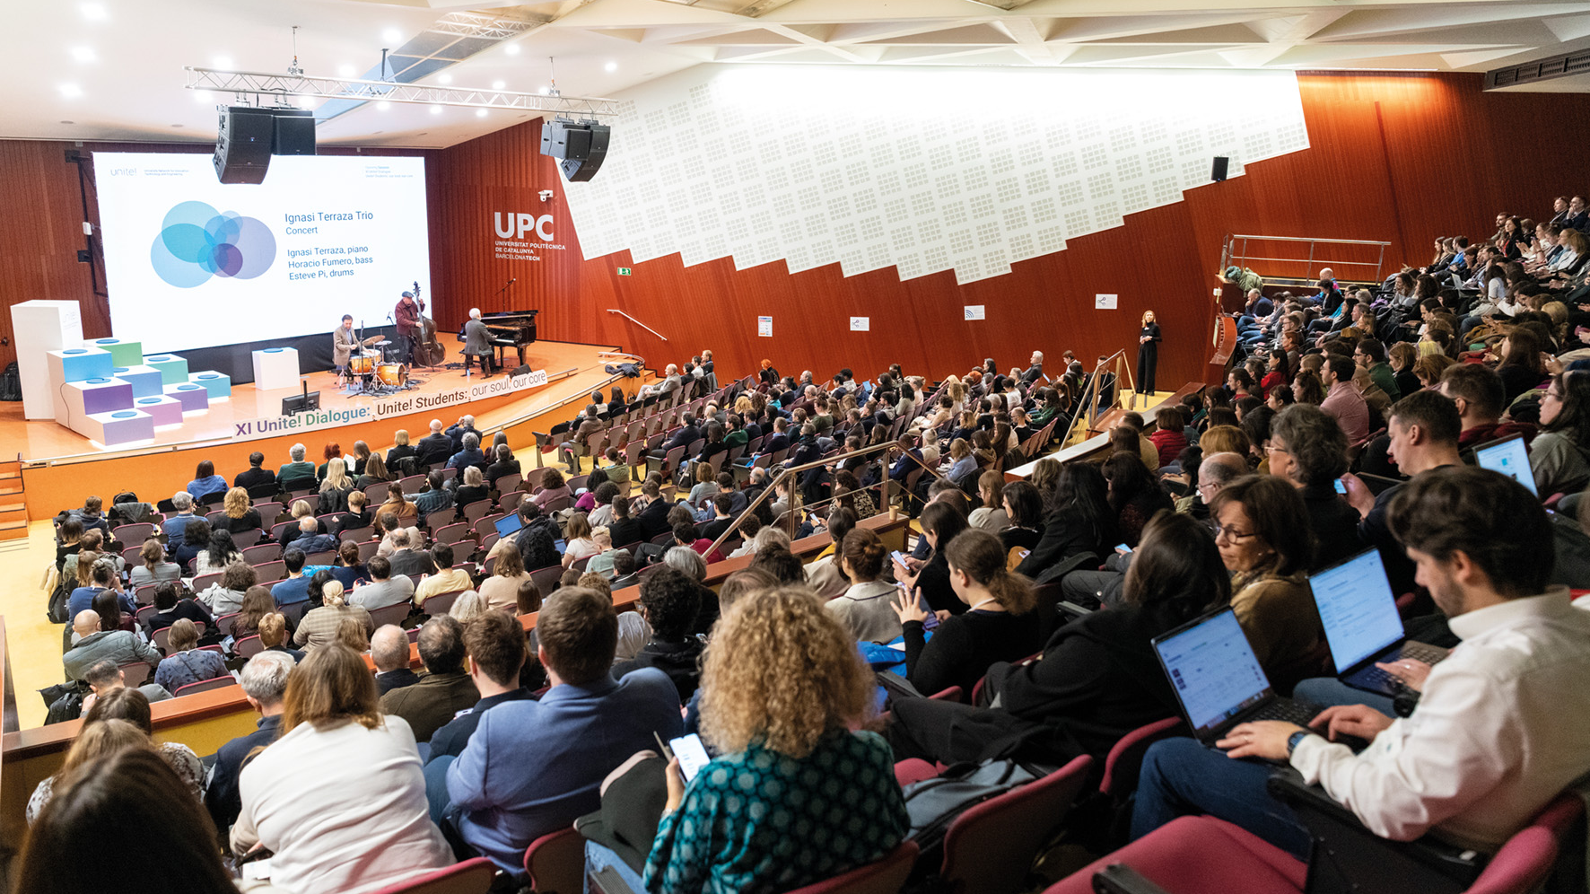

Slide 28
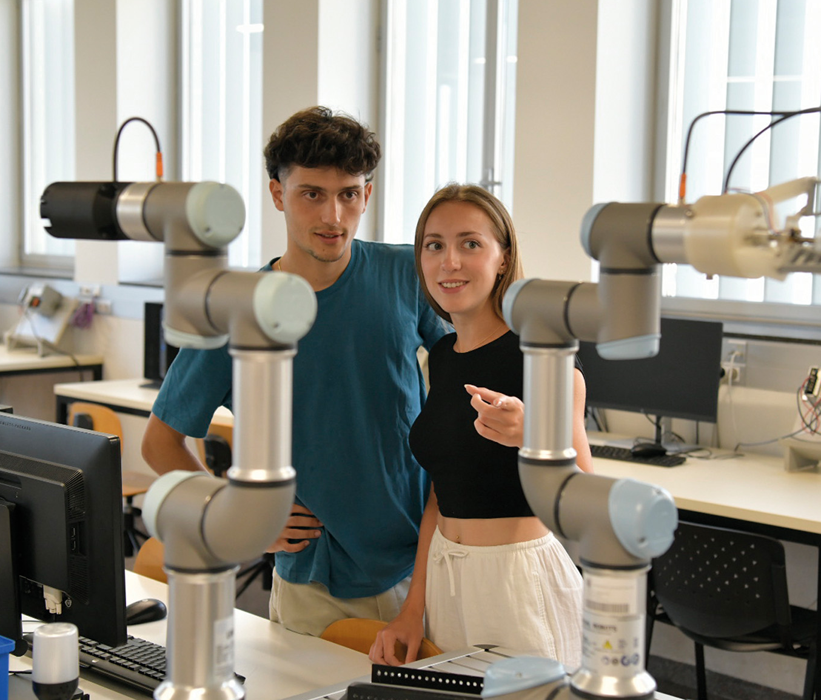
University studies
2025-2026 academic year
www.upc.edu/en
Bachelor’s degrees
www.upc.edu/en/bachelors/
Master’s degrees
www.upc.edu/en/masters/
Doctoral programmes
doctorat.upc.edu/en/programmes/
Continuing education
www.talent.upc.edu/ing

Slide 29
The UPC, the public university of engineering, architecture, sciences and technology

Slide 30
The UPC today

